Slide 1
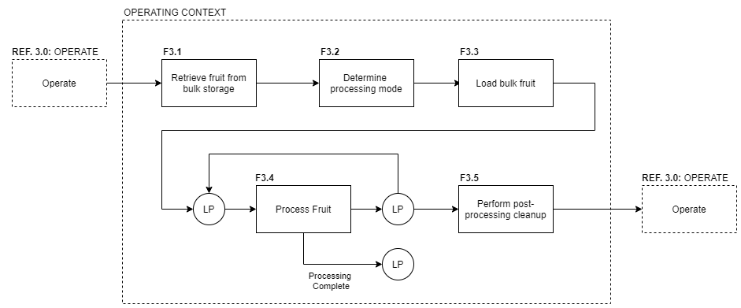
AFPS – Basic FBA

Slide 2
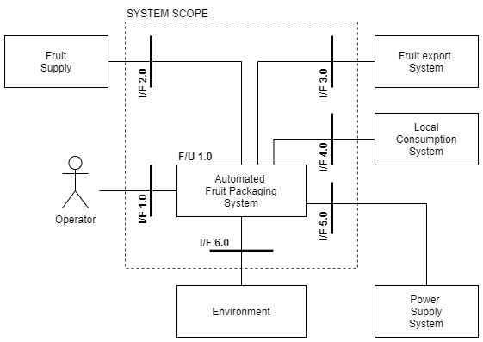
AFPS – Initial architecture

Slide 3
Sanity Check

Slide 4
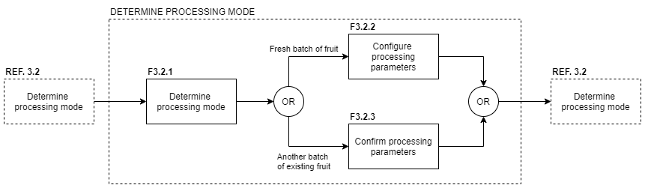
Expanding the FFBD

Slide 5
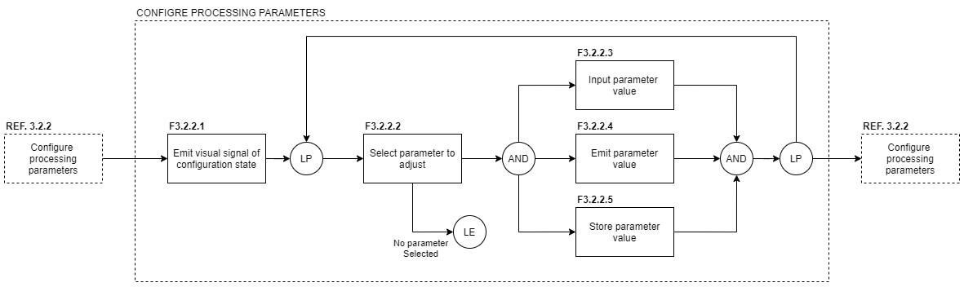
Expanding the FFBD

Slide 6
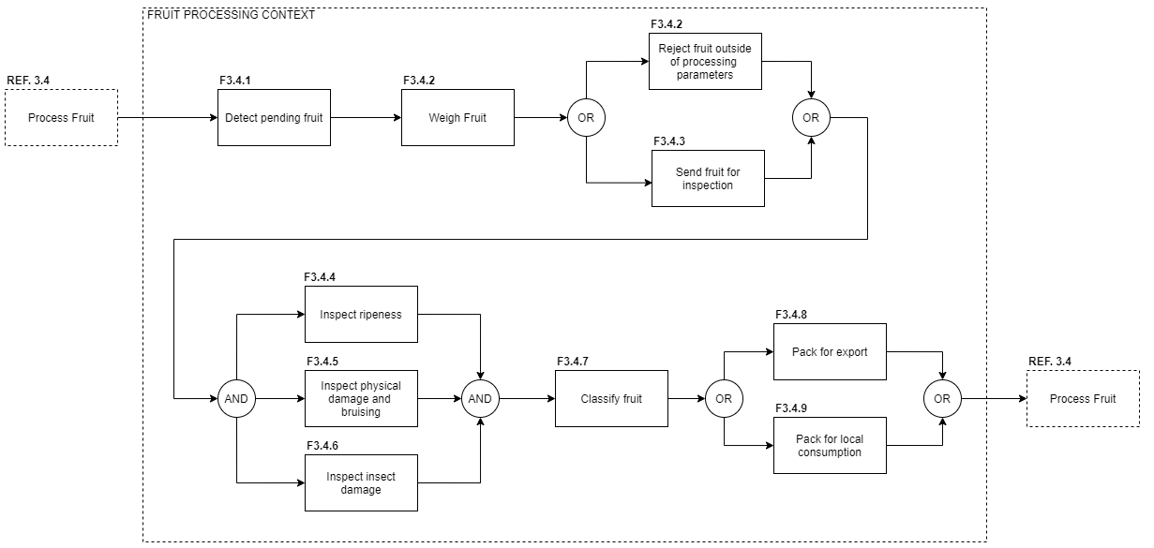
Expanding the FFBD

Slide 7
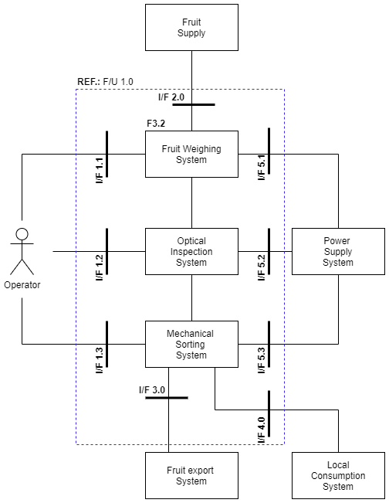
Expanding the architecture

Slide 8
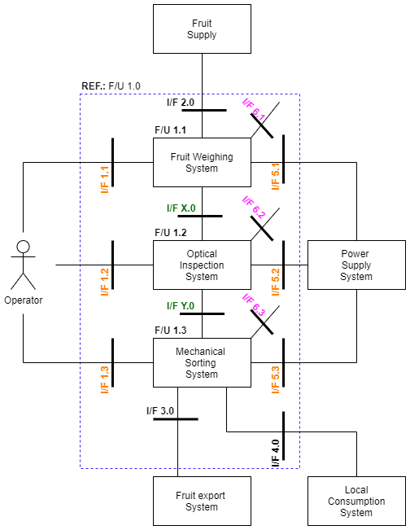

Correct obvious mistake…
Notes:
Here the mapping between the PA and the FBA begins to take shape. However, F3.4.2 which maps to F/U1.1 has a problem. Based on the desired functionality it has to be able to reject fruit, yet there is no way (based on the current PA) to accomplish this. All fruit has to be sent for inspection!!!
This has the following implications:
The context diagram needs to be modified to include a reject fruit system external to the SoI
The PA has to be modified to match (both levels)!
This glitch has been caught early enough so the amount of rework is not too much. However, still quite a bit of work…

Slide 9

?

